Slide 1
HEALTHCARE
ANALYTICS
EDA & Dashboard Project
Python | Excel | Power BI | Tableau
Patient • Clinical • Admission • Billing Analysis

Slide 2
2
Project Objective
How are patients distributed across age, gender and medical conditions?
Which admission types and test-result categories are most common?
How do medications and insurance providers compare by patient volume and billing?
How does patient volume change over time?
How can EDA findings be converted into clear, decision-ready dashboards?

Slide 3
3
Dataset Overview
Records
55,500
Columns
15
Average Age
51.54 yrs
Avg. Billing
25,539.32
DATA RANGE
Age: 13–89 years • Billing: -2,008.49 to 52,764.28
DATA COMPLETENESS
All 15 fields contain 55,500 non-null records.
MAIN DOMAINS
Demographics, clinical conditions, hospital details, admissions, insurance and billing.
EDA COVERAGE
Cleaning, duplicates, unique values, distributions, grouping and summary statistics.

Slide 4
4
Data Quality & EDA Findings
Missing Values
0
Duplicate Rows
534
Test Result Categories
3
Missing-value check: no missing values were found.
Duplicate check: 534 duplicate rows were identified and should be reviewed.
Test Results contains Normal, Inconclusive and Abnormal.
Billing contains a negative minimum value, which should be investigated as a potential anomaly before financial reporting.

Slide 5
5
Medical Condition Analysis
HIGHEST
Arthritis — 9,308 patients
LOWEST
Asthma — 9,185 patients
INTERPRETATION
The condition mix is relatively balanced, with only a small difference between highest and lowest counts.

Slide 6
6
Admission Type Analysis
ELECTIVE
18,655 patients
URGENT
18,576 patients
EMERGENCY
18,269 patients

Slide 7
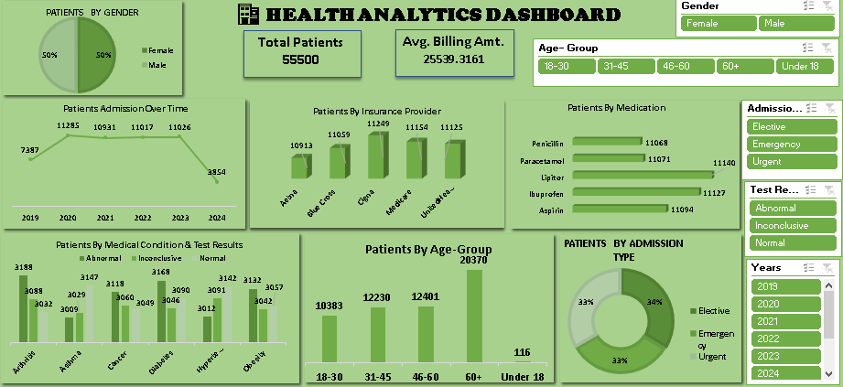
7
Excel Dashboard
WHAT IT SHOWS
KPIs, trends, medical conditions, medication, insurance, age group, gender and admission type.
KEY FEATURES
Slicers for Gender, Age Group, Admission Type, Test Results and Years.
USE CASE
Strong for Pivot-based reporting and quick interactive filtering.

Slide 8
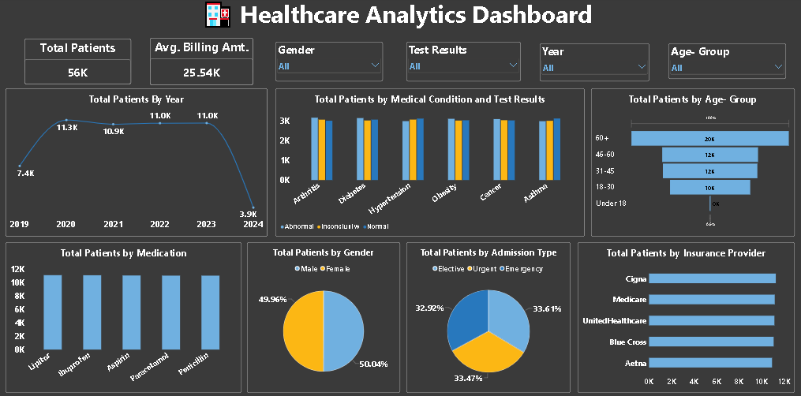
8
Power BI Dashboard
WHAT IT SHOWS
Yearly patient trend plus clinical, admission, medication, insurance, age and gender views.
KEY FEATURES
KPI cards and multiple business-style visuals in one report page.
USE CASE
Strong for interactive business intelligence and decision-ready reporting.

Slide 9
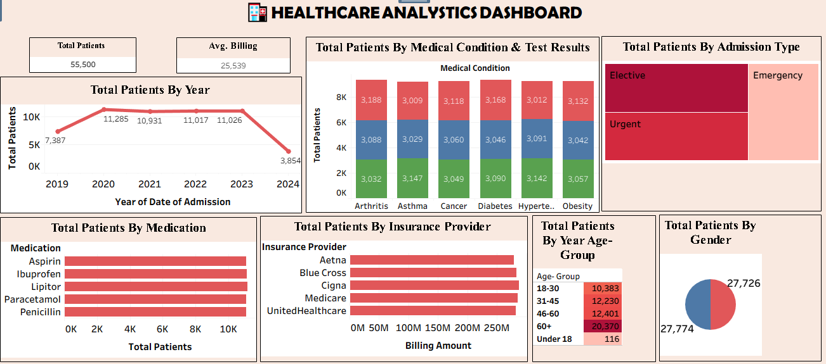
9
Tableau Dashboard
WHAT IT SHOWS
KPI cards, filters and visuals for year, age group, gender, test results and clinical dimensions.
KEY FEATURES
Interactive filtering with a compact executive-dashboard layout.
USE CASE
Strong for visual exploration and storytelling across dimensions.

Slide 10
10
Tool Comparison
Python EDA
Cleaning • statistics • anomaly detection
Deep analytical work
Excel
Pivot tables • quick charts • slicers
Fast reporting
Power BI
Interactive BI • KPIs • filters
Business dashboards
Tableau
Visual exploration • storytelling
Interactive analytics

Slide 11
11
Key Insights
55,500 patient records provide a strong base for multi-dimensional analysis.
Average patient age is about 51.54 years.
Arthritis has the highest condition count; Asthma has the lowest among the six listed conditions.
Elective, Urgent and Emergency admissions are relatively balanced.
Dashboard screenshots show an almost equal gender split.
Data is complete, but duplicates and the negative billing value should be reviewed.
Combining Python EDA with BI dashboards gives both analytical depth and business-friendly communication.

Slide 12
12
Recommended Analytics Workflow
01
Clean
Missing values • duplicates • anomalies
02
Explore
Distributions • groups • trends
03
Calculate
KPIs • counts • averages • comparisons
04
Visualize
Excel • Power BI • Tableau
05
Interpret
Insights • actions • recommendations

Slide 13
HEALTHCARE ANALYTICS
13
CONCLUSION
Python EDA establishes data quality and analytical understanding.
Excel supports fast Pivot-based reporting.
Power BI and Tableau turn the analysis into interactive dashboards.
The final healthcare dashboard should be validated against the underlying data and filter context.
Together, these tools create a complete analytics workflow from data to insight.

